Slide 1
Vaping, Consumer Risk Perceptions, and Advertising
Don Kenkel
Cornell University & NBER
Tobacco Online Policy Seminar
October 16, 2020

Slide 2
Disclosures
“Mostly harmless regulation? Electronic cigarettes, public policy, and consumer welfare” (with Peng, Pesko, and Wang). Health Economics 2020. Internal funding from Cornell University.
“Does e-cigarette advertising encourage adult smokers to quit?” (with Dave, Dench, Grossman, and Saffer). Journal of Health Economics December 2019. NIH funding to the NBER.
“News that takes your breath away: risk perceptions during an outbreak of vaping-related lung injuries.” (with Dave, Dench, Mathios, and Wang). Journal of Risk & Uncertainty 2020. No external funding.
Work in progress. Funding from the Foundation for a Smoke-Free World to Cornell University.
Kenkel has served as a paid consultant to the Foundation for a Smoke-Free World.

Slide 3
Major themes of my talk
Consumers value their health, which creates consumer demand for healthier behaviors and healthier tobacco products
Private sector advertising can promote public health
Public policies matter too
Minor theme: methods to study markets
Experimental markets (Discrete Choice Experiment)
Identification of advertising effects in observational data
Information shock as a quasi-experiment

Slide 4
The value of health
Economists estimate that the “value of a statistical life” = $10 million
VSL summarizes estimates of the value of risks (not life itself!), based on evidence that workers are willing to accept lower wages to get safer jobs
In US, smoking is estimated to cause almost 500K extra deaths/ year
Smokers’ life expectancy reduced by 10 years
Using the VSL, health economists estimate that smokers impose health costs on themselves worth at least $34 per pack
“Full price” = monetary price + health cost ≈ $10 (in NY) + $34 = $44/pack
Changes in the perceived health costs of smoking can have a very large impact on the perceived full price
(Many excise tax hikes are small in comparison to the health costs)

Slide 5
Consumers (even smokers!) want to be healthier
In the 1950s and 1960s research established the major health costs of smoking
U.S. smoking prevalence dropped from over 40% in 1965 to 18% in 2018
Mendez and Warner show that the demography of the smoking population in 1995 – which reflects the earlier smoking changes – predict the observed drop in smoking prevalence from 1995 to 2010.
Smokers’ average cons dropped from 30+ cigs/day in 1983 to 23 cigs/day in 2010
Smokers are more likely to quit at younger ages
Quitters age 35-44 gain back 9 years of the 10 years average loss
Filtered market share increased from 58% in 1963 to 99.8% in 2011
Low-tar market share increased from 2% in 1967 to 94.7% in 2011
Didn’t help!

Slide 6
New frontier of harm reduction: non-combustible nicotine & tobacco products
Nicotine replacement products – including the nicotine inhaler – are approved safe for over-the-counter sale
“There is conclusive evidence that completely substituting e-cigarettes for combustible tobacco cigarettes reduces users’ exposure to numerous toxicants and carcinogens present in combustible tobacco cigarettes.” (National Academy of Sciences 2018, emphasis in original to indicate highest evidence standard)
FDA Center for Tobacco Products Modified Risk Tobacco Product actions:
In 2019, authorized Swedish Snus (smokeless tobacco) to market as a reduced-risk product
In 2020, authorized IQOS (heat-not-burn) to market as a reduced-exposure product
Evidence supporting harm reduction potential
Toxicological analysis of vapor versus tobacco smoke
Observational data
But we lack evidence from RCTs (not ethical)

Slide 7
Parachute use to prevent death and major trauma related
to gravitational challenge: systematic review of
randomised controlled trials
Gordon C S Smith, Jill P Pell
BMJ VOLUME 327 20–27 DECEMBER 2003
Conclusions As with many interventions intended to
prevent ill health, the effectiveness of parachutes has
not been subjected to rigorous evaluation by using
randomised controlled trials. Advocates of evidence
based medicine have criticised the adoption of
interventions evaluated by using only observational
data. We think that everyone might benefit if the most
radical protagonists of evidence based medicine
organised and participated in a double blind,
randomised, placebo controlled, crossover trial of the
parachute.
An Unproven Harm Reduction Product

Slide 8
Study 1

Slide 9
Mostly harmless regulation of e-cigs
We designed a discrete choice experiment (DCE) to study the impact of possible FDA regulations of e-cigs. Experimentally varied:
Warning labels
Availability of flavors
Price
Subjects = adult smokers (cigs were the outside option in the DCE)
DCEs provide stated-preference data in settings when revealed-preference data from actual markets aren’t available
Also collected information on consumer information about e-cigs
Asked the info questions after the DCE questions
Use the estimates of consumer optimization errors in our cost-benefit analysis of policy scenarios

Slide 10
Table 2 Consumer optimization errors (red = misinformation)
 | Mean | Min | Max
# deaths out of 100 users of e-cigarettes | 30.1 | 0 | 100
# deaths out of 100 users of cigarettes | 45.7 | 0 | 100
# deaths out of 100 users of NRPs | 27.8 | 0.34 | 80.5
β-discount (present bias) factor | 0.73 | 0.0082 | 1.24
Little present bias (β-discount factor > 0.9) | 0.37 | 0 | 1
Interested in using a Commitment Contract | 0.20 | 0 | 1
Respondents | 1,148

Slide 11
Policy simulations based on estimated model
 | Use | Use | Use
 | e-cigarettes | cigarettes | NRPs
Pre-2016 FDA market conditions | 16% | 71% | 13%
Policy counter-factuals:
Ban flavors | 16% | 71% | 13%
FDA warning | 17% | 68% | 15%
Reduced risk warning | 17% | 68% | 15%
MarkTen warning | 13% | 72% | 15%
$3 Tax | 14% | 71% | 15%
$3 Subsidy | 30% | 57% | 13%
Ban flavors & FDA waning | 15% | 70% | 15%
Ban e-cigarettes | 0% | 82% | 18%
Consumer optimization error counter-factuals:
Correcting risk misperceptions | 22% | 60% | 18%
Correcting naiveté about time inconsistency | 27% | 51% | 22%
Correcting risk misperceptions & Naiveté about time inconsistency | 32% | 42% | 26%

Slide 12
Take-aways
Correcting risk misperceptions could ↓ smoking & ↑ e-cig use
FDA e-cig regulations appear to be mostly harmless
FDA warning label -- doesn’t change behavior much
(Mark-10 warning label might ↑ smoking)
FDA’s recent flavor ban probably won’t change adult smokers’ behavior much
Data pre-date Juul, so results might not extrapolate
$3 e-cig subsidy passes cost-benefit test
Yields predicted rates of vaping/smoking similar to normative behavior of well-informed, not present biased consumers

Slide 13
Study 2

Slide 14
Does e-cigarette advertising encourage adult smokers to quit?
Spoiler Alert: the answer is YES (for TV ads, not magazine ads)
In U.S., e-cigarettes are allowed to advertise on TV, magazines, etc.
Cigarette advertising on TV & radio has been banned in U.S. since 1972, but ban hasn’t applied to e-cigs
As a result of litigation, e-cig advertisements do NOT make explicit health claims or cessation claims.
“Image advertising” that links product to attractive people & places
Situation will change w/full implementation of FDA “deeming rule”
E-cig advertising expenditures increased from $3.6 million in 2010 to $112 million in 2014

Slide 16
Identifying the causal effect of advertising
Literally a textbook example of simultaneous equations & endogeneity bias
Does advertising cause the consuming?
Or does consuming cause the advertising?
Our e-cig study uses a “saturated fixed effects identification strategy”
Most complete specifications are saturated with year-quarter, magazine, program, time slot, and channel fixed effects.
Identifying variation comes from within-program/time slot/channel variation in ads over time (controlling for general time effects)
Example: someone who watched the Big Bang Theory in 2015q1 exposed to almost 4 times more ads than someone who watched in 2014q1
Builds off the approach Avery, Kenkel, Lillard, and Mathios (2007 JPE) developed in response to a tough referee

Slide 18
Take-aways
We estimate that increased exposure to e-cig ads on TV has a stat sig’t but small effect on adult quitting
1 more TV ad → quit rate ↑ by 1% (NOT 1 percentage point)
Estimates of large advertising effects are not credible, because they imply that firms could increase profits by advertising more
Our estimate implies that a complete advertising ban during our sample period would have decreased smoking cessation from 9% to 8.7%
Informative ads that include accurate claims about health and cessation benefits could be much more effective
Pursuit of private profits could promote public health

Slide 19
Study 3

Slide 20
News that takes your breath away: risk perceptions during EVALI
EVALI = e-cigarette, or vaping, associated lung injury
EVALI outbreak was an information shock for the e-cig market
Lung injuries recognized in summer 2019, peaked in September 2019
As of February 2020 (final CDC update):
2,807 hospitalizations due to EVALI
68 confirmed deaths due to EVALI
EVALI was almost certainly caused by illegal THC-vaping products, not commercially produced nicotine-vaping products
Vitamin E-acetate added to THC products
Recent report: 14 of 18 rats exposed to e-cig vapor (no THC or Vit E) developed acute respiratory distress, when the lab switched e-cig heating element

Slide 23
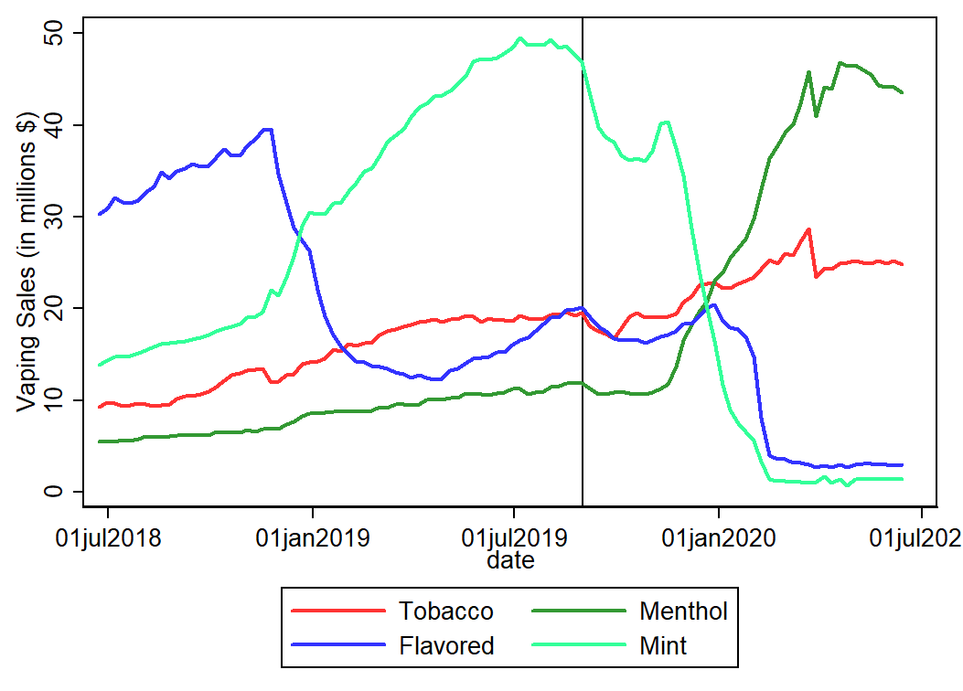

Slide 24
Take-aways
EVALI outbreak was an information shock to the e-cig market
Higher fraction incorrectly think that e-cigs are more harmful than cigs
Respondents don’t distinguish between risk of THC- vs nicotine e-cigs
E-cig sales dropped immediately after EVALI peaks
Many other forces at work on the e-cig market!
Preliminary calculations based on our estimates imply that the info shock led to:
7.6% ↓ in quitting
212K fewer quitters/ year
Work-in-progress extends the analysis into 2020
“Smoking in the Time of COVID-19”

Slide 25
